Slide 1

Reference management tools - an introduction
Notes:
Presenter will need to have an account with a ref man tool, a desktop version of Mendeley or Zotero as well as being logged into web version.

Slide 2
Learning outcomes
By the end of this session you should have an overview of:
How reference management tools work,
The benefits and risks of using these tools
How the tools work with Library resources

Slide 3
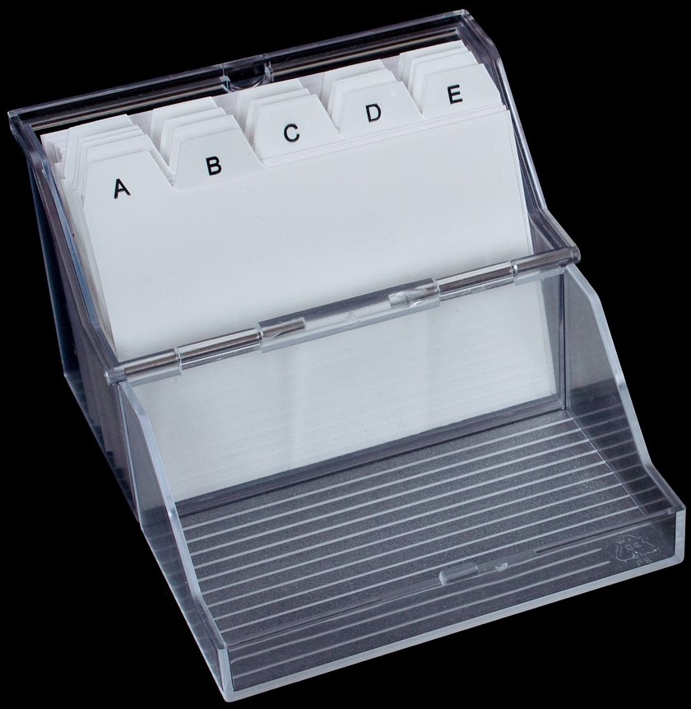
Some ways of managing references
Card file
Word document
Excel spreadsheet
Reference management tool
How do you manage your references?
Notes:
References can be managed in a number of ways, what works best for you is the most important thing. Ask participants how they manage their references at the moment

Slide 4
Reference management tools

Slide 5
What do the tools do?
Store your references ​
- From your module material, web sites, library resources (so can be used to collect resources together as you are researching)​
Manage your references​
- Use folders, keywords, add notes​
Cite your references​
- Create citations and bibliographies in a particular style with word processing​

Slide 6
Have you heard of any of these?
Mendeley​
Zotero​
Endnote basic​
Cite this for me​
None of these​
Notes:
Poll – explain it doesn’t matter if they haven’t, just the names of some of the most popular tools

Slide 7






Freely available on the web
Need to purchase
Notes:
There are many freely available tools on the web, they are not supported by us and this is just a small selection of the best known ones.
Endnote can be purchased at a discount via Adept Scientific but is considered to be the Rolls Royce of these kind of tools and is really suitable for PhD students and academics engaged in research certainly not for undergraduates, or even masters students. The OU has a site licence for this so full time research students and staff on campus can access it for free.
Papers is software which can be used on Apple products and again needs to be purchased.

Slide 8


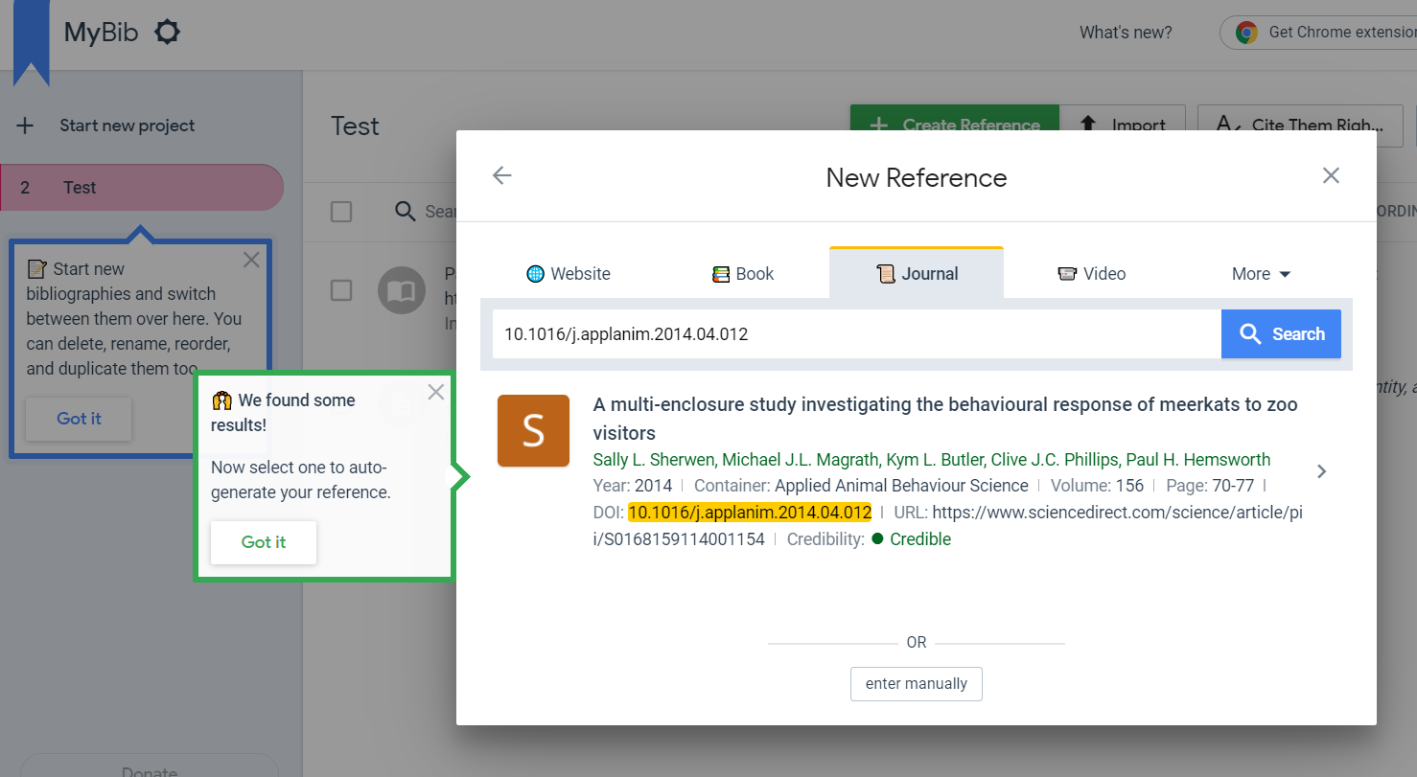
Citation generators

Slide 9
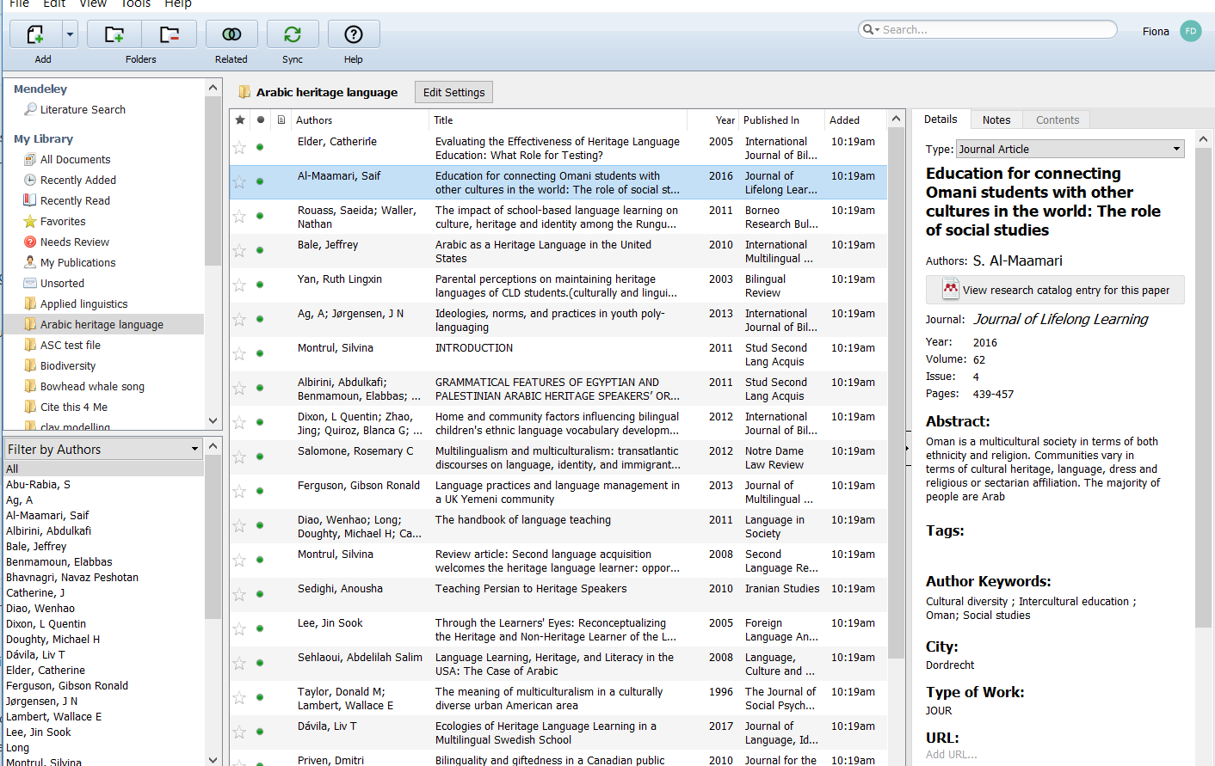
Notes:
Example of a Mendeley Library showing folders on left, list of resources and details in middle one highlighted resource, details on right, this is where metadata can be edited and notes added. Point to relevant bits.

Slide 10
Adding references to your reference management tool

Slide 11
Ways of adding references
Manually
Via the OU Library website or database
Browser extension
Importing a file (PDF)
Importing a .ris file

Slide 12
Demonstration
Notes:
Show Library Search export. Show database export (Academic Search Complete?) Show pulling a PDF into Mendeley. Point out browser extensions – may use screenshot on slide here.

Slide 13
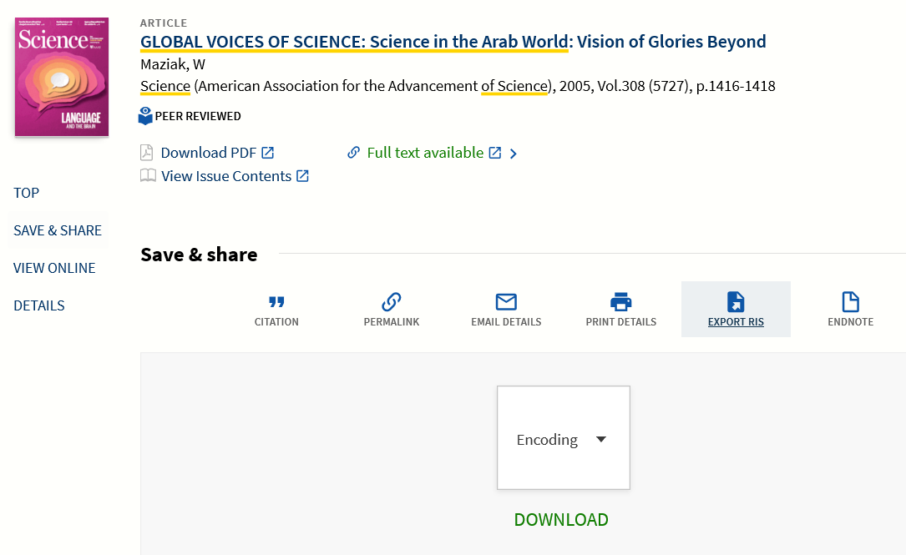
Notes:
Details of articles books etc can be exported from Library Search either individually or as a group from my favourites, using ‘Export RIS’ This is a type of file which can be read by databases and the reference management tools. Point out mistake in title field, capital letters

Slide 14
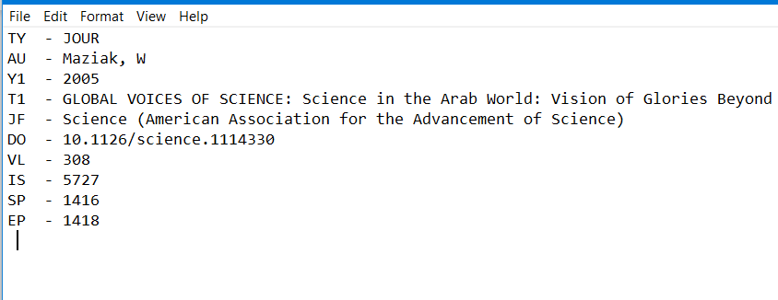

Slide 15
Reference styles

Slide 16
Referencing styles
OU Harvard
Cite Them Right (CTR) Harvard
OSCOLA
Others – more than you could possibly imagine

Slide 17
What mistakes can you spot from these Mendeley imported citations?
Imported to Mendeley:
Anand, P. (2005) ‘Capabilities and health’. doi: 10.1136/jme.2004.008706.
Correct reference (CTR)
Anand, P. (2005) ‘Capabilities and health’, Journal of medical ethics, 31(5), pp. 299–303. doi: 10.1136/jme.2004.008706.

Slide 18
What mistakes can you spot from these Mendeley citations?
Imported to Mendeley:
BRILEY, D. A., RUDD, M. and AAKER, J. (2017) ‘Cultivating Optimism: How to Frame Your Future during a Health Challenge.’, Journal of Consumer Research. Oxford University Press / USA, 44(4), pp. 895–915. Available at: http://10.0.4.69/jcr/ucx075.
Correct reference (CTR)
Briley, D.A., Rudd, M. and Aaker, J. (2017) ‘Cultivating Optimism: How to Frame Your Future during a Health Challenge’, The Journal of Consumer Research, 44(4), pp. 895–915. doi: 10.1093/jcr/ucx075.

Slide 19
Working with Word

Slide 20
Word add ons
In text citations
Reference lists
Bibliographies

Slide 21
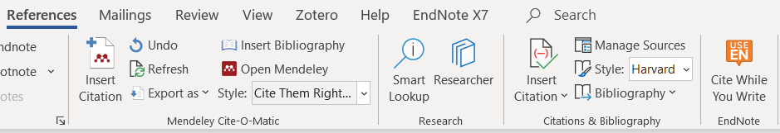
Using Word
The reference management tool inserts a new toolbar into your Word programme
Notes:
You won’t have all these add ons, choose one and stick to it! Tools allow you to insert a new toolbar into Word in order to make citing references and creating bibliographies easier.

Slide 22
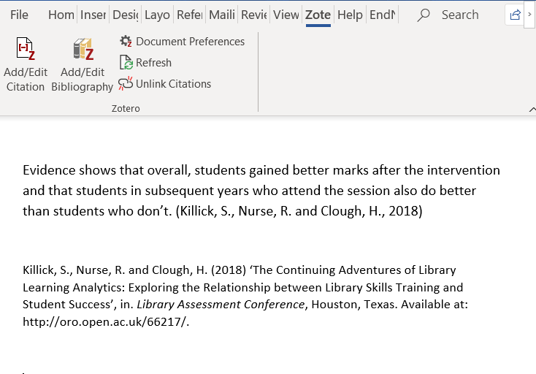

Slide 23
How do you plan to manage your references in future?
I will try one of the tools
I will stick with the method I use now
Not decided

Slide 24
We have covered
How reference management tools work,
The benefits and risks of using these tools
How the tools work with Library resources
For further information see the Bibliographic Management page on the Library website

Slide 25

Fill in the feedback form for a chance to win
a £10 Amazon voucher!
Any questions?
Notes:
Any questions?

Slide 26
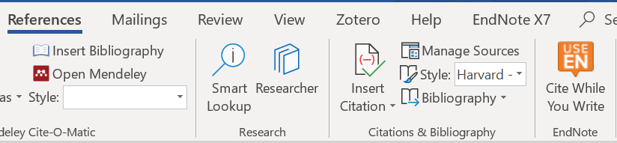
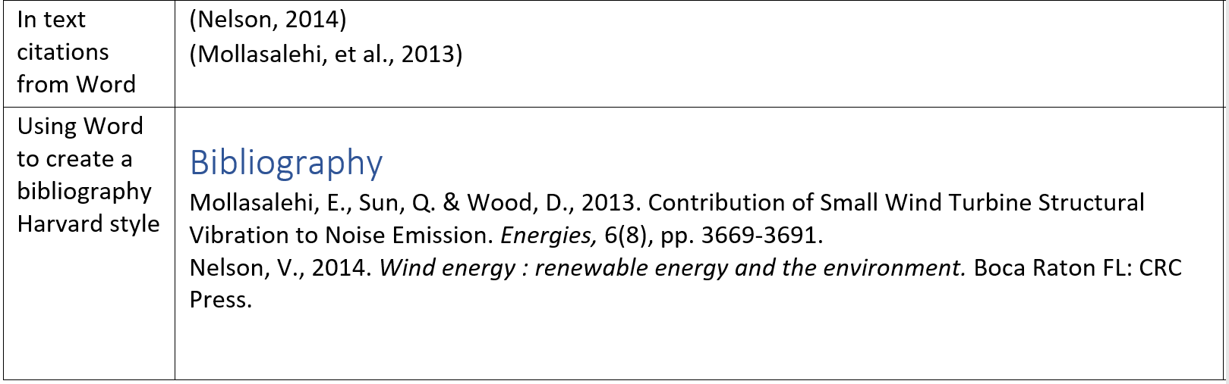
Using Word as a reference management tool
Notes:
Supplementary material, only use if any one asks about the integral Word reference management tool This is in the references tool bar. Very limited number of styles, Harvard is Anglian version, Need to add details manually. As this is Office 365 do lists transfer to other devices?

Slide 27
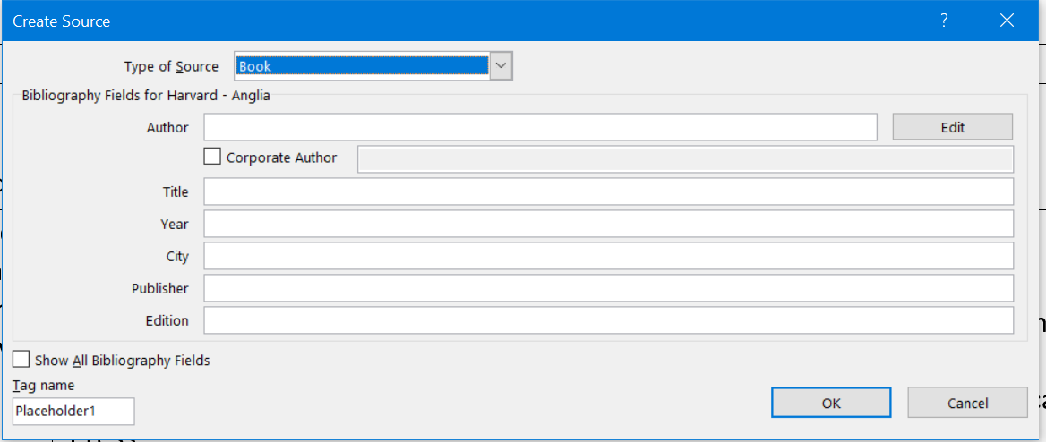
Word form to fill in for citations

Slide 28

Browser extensions in Chrome
Zotero
Mendeley
Endnote
Notes:
Supplementary if presenter does not have these in their own browser

